Slide 1






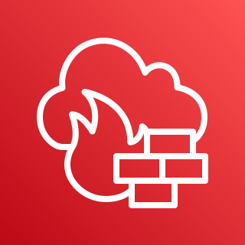

















End User
VPN Connection over internet
AWS Cloud
IGW
VPC
Availability Zone 2
Firewall
Availability Zone 1
Firewall
Availability Zone 2
NAT Gateway
Load Balancer
NAT Gateway
Load Balancer
NAT Gateway
VPN Servers
ASG
File Transfer Servers
ASG
Presentation & Admin Subnet
Bastion Hosts
ASG
Web Portal
ASG
IAM
Std.
AWS KMS
Glacier
Glacier
Deep
Archive
Secrets Manager
App Subnet
IPND Core
ASG
IIS App Servers
ASG
Amazon RDS
Amazon RDS
Data Subnet
Secondary/Failover Zone
Primary Zone
Secondary/Failover Zone
CloudWatch and CloudTrail

Slide 2
End User
VPN Connection over internet
AWS Cloud
IGW
VPC
Availability Zone 2
Firewall
Availability Zone 1
Firewall
Availability Zone 2
NAT Gateway
Load Balancer
NAT Gateway
Load Balancer
NAT Gateway
VPN Servers
ASG
File Transfer Servers
ASG
Presentation & Admin Subnet
Bastion Hosts
ASG
Web Portal
ASG
Std.
Glacier
Glacier
Deep
Archive
App Subnet
IPND Core
ASG
IIS App Servers
ASG
Amazon RDS
Amazon RDS
Data Subnet
Secondary/Failover Zone
Primary Zone
Secondary/Failover Zone
CloudWatch and CloudTrail

